Slide 1
CS 4530
Fundamentals of Software Engineering
Module 18: Engineering Software for Equity
Adeel Bhutta, Jan Vitek, Mitch Wand
Khoury College of Computer Sciences
© 2023 Released under the CC BY-SA license

Slide 2
Learning Goals
By the end of this lesson, you should be able to…
Illustrate how software can cause inadvertent harm or amplify inequities
Explain the role of software engineers in avoiding such harms

Slide 3
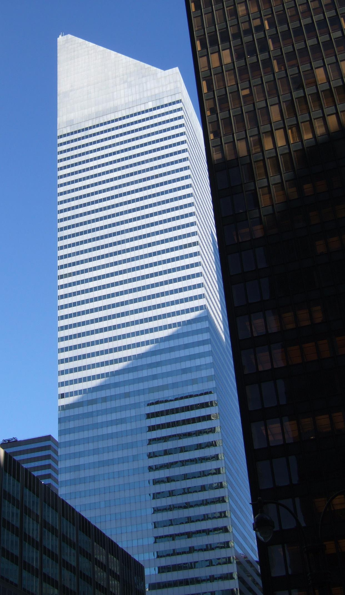
Code of Ethics
Professional Engineers
Engineers, in the fulfillment of their professional duties, shall:
Hold paramount the safety, health, and welfare of the public.
Perform services only in areas of their competence.
Issue public statements only in an objective and truthful manner.
Act for each employer or client as faithful agents or trustees.
Avoid deceptive acts.
Conduct themselves honorably, responsibly, ethically, and lawfully so as to enhance the honor, reputation, and usefulness of the profession.
National Society of Professional Engineers - Code of Ethics for Engineers
Notes:
Given that we’re talking about SOFTWARE engineering, it’s particularly useful to consider the closely related ethical problems that arise in civil engineering. Whereas it might be difficult to identify an immediate risk to life from a failure of most software, it is much easier to see how a miscalculation in the design of a building could result in the building to collapse, which would be catastrophic. Professional engineers are required to receive significant training in ethics to ensure that they understand the importance of, above all, ensuring the safety, health and welfare of the public. The building shown on this slide, the Citigroup tower in new york city, provides a particularly interesting case study of ethics in engineering.

Slide 4
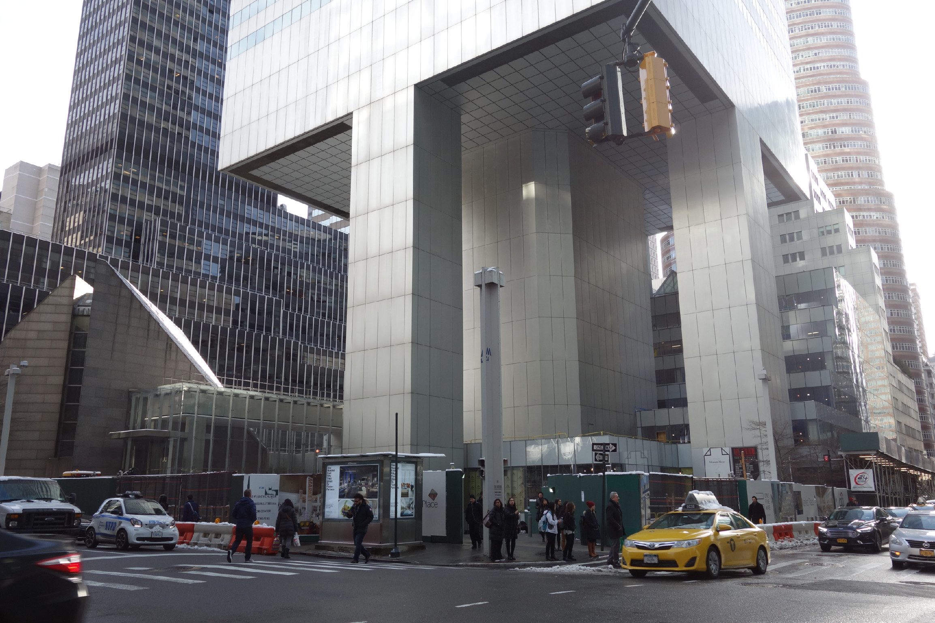
Code of Ethics
Professional Engineers: Citigroup Center
Design met building code, but did not account for all failure modes
Last-minute changes to construction increased odds of failure
Fixed before disaster could strike, but kept a secret for 20 years
https://en.wikipedia.org/wiki/Citicorp_Center_engineering_crisis
“Citigroup Center” by Tdorante10, Wikimedia commons, CC BY-SA 4.0
Notes:
Here’s a photo of the bottom of Citigroup Center, which was built 1974. It’s a very interesting building design: a 59 story tower cantilevered over a church - note this unique column architecture supporting the building. The engineer, LeMessurier, created a design that met building code (which in particular, required the design to be resilient to winds from N/S/E/W), but an analysis by an undergrad’s senior thesis found a diagonal hurricane-force wind would quite likely blow over the building. Usually face-on winds are the worst (for a building with columns on corners), but this building had columns in middle! Would have been OK if bottom joints were welded, but steel contractor wanted to bolt them to save millions of dollars, and was OKed. Fixed by the engineering firm, quite quickly, but also quietly. While being fixed added extra precautions to ensure safety and monitor weather, with evacuation plans. Kept secret for 20 years! This is a very interesting case study: note that the engineer did follow regulations, but still did not ensure safety in their design. Thankfully, the flaw was found by the student, and the engineering firm quickly took action to repair it, taking responsibility for the problem. One interesting discussion point here, however, is regarding how it was repaired - in secret!
Do you think that this design flaw should have been made immediately public?

Slide 5
Badly-engineered software can kill people
Therac-25 (1985-1987)
Bug in software caused 100x greater exposure to radiation than intended
At least 6 died
Likely far more suffered: deaths occurred over a period of 2 years!
Weak accountability in manufacturer’s organization
https://ethicsunwrapped.utexas.edu/case-study/therac-25
“Therac-25” by Catalina Márquez, Wikimedia commons, CC BY-SA 4.0
Notes:
In contrast to the Citigroup tower case, where the engineering firm took responsibility for the failure and rectified it, let’s consider another classic professional ethics case, this one, from software engineering. A bug in the software controlling the THERAC-25 radiation treatment machine resulted in the death of at least 6 patients, and administered countless additional overdoses. Investigations after-the-fact found that the manufacturer had extremely poor software development and quality assurance processes, without independent code review, without testing, and without safety checks. The machine operators were assured that overdoses were impossible - software was reused from older machines which had hardware interlocks to prevent these software defects from being catastrophic. Note that one result of this incident is stronger standards for safety-critical (in particular: medical) software, which now require rigorous quality assurance practices. The manufacturer of the machine, however, could have easily prevented further damage had they immediately detected and resolved the bug after the first reported incident in 1985.
Discussion Questions:
1. Who should be responsible for the errors in a medical device?
2. What moral responsibility do creators of software have for the adverse consequences that flow from flaws in that software?

Slide 6
Code of Ethics
ACM’s Code of Ethics Software Engineers
1. PUBLIC – Software engineers shall act consistently with the public interest.
2. CLIENT AND EMPLOYER – Software engineers shall act in a manner that is in the best interests of their client and employer consistent with the public interest.
3. PRODUCT – Software engineers shall ensure that their products and related modifications meet the highest professional standards possible.
4. JUDGMENT – Software engineers shall maintain integrity and independence in their professional judgment.
5. MANAGEMENT – Software engineering managers and leaders shall subscribe to and promote an ethical approach to the management of software development and maintenance.
6. PROFESSION – Software engineers shall advance the integrity and reputation of the profession consistent with the public interest.
7. COLLEAGUES – Software engineers shall be fair to and supportive of their colleagues.
8. SELF – Software engineers shall participate in lifelong learning regarding the practice of their profession and shall promote an ethical approach to the practice of the profession.
1. PUBLIC – Software engineers shall act consistently with the public interest.
https://ethics.acm.org/code-of-ethics/software-engineering-code/
Notes:
Software Engineers are not legally held to any code of ethics, and unlike many other professionals (like lawyers, doctors, and civil engineers), we are not licensed by a professional society who holds us to ethical standards. Nonetheless, the ACM, one of the largest professional societies for computer scientists, has established a code of ethics for software engineers. This code is quite similar to those for professional engineers, and includes as the first tenet, (click) that software engineers should act consistently with the public interest - both doing no harm to the public, and hopefully doing good.

Slide 7
Equity and Software
As new as software engineering is,
we’re newer still at understanding its impact on underrepresented people and diverse societies
We must recognize imbalance of power between those who make development decisions that impact the world
and those who simply must accept and live with those decisions that sometimes disadvantage already marginalized communities globally
Quote: “Software Engineering at Google: Lessons Learned from Programming Over Time,” Wright et al, 2020 (O’Reilly)
Notes:
This is a particularly important topic for a class on software engineering, as there is an enormous imbalance of power between those of us who make software development decisions, building software that’s used broadly, and the rest of the world that simply must accept and live with those decisions. As software engineers, you will likely wield more power than you realize.

Slide 8
Recognize inequities in your software
One mark of an exceptional engineer is the ability to understand how products can advantage and disadvantage different groups of human beings
Engineers are expected to have technical aptitude, but they should also have the discernment to know when to build something and when not to
Demma Rodriguez Head of Equity Engineering
Google
Quote: “Software Engineering at Google: Lessons Learned from Programming Over Time,” Wright et al, 2020 (O’Reilly)
Notes:
Being an exceptional engineer means not only know HOW to build some killer features, but that you have the judgement to be able to identify and reject features or products that drive adverse outcomes.

Slide 9
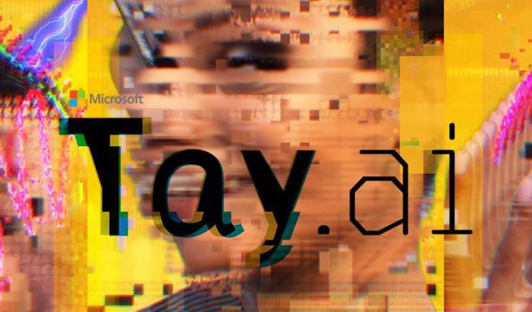
Recognize inequities in your software
Good engineers understand how products can be weaponized to create harms in certain groups
Microsoft failed with a chatbot that picked up the behavior people used…
…they taught Tay to use offensive and racist language attacking jews
Notes:
Being an exceptional engineer means not only know HOW to build some killer features, but that you have the judgement to be able to identify and reject features or products that drive adverse outcomes. It took less than 24 hours for Twitter to corrupt an innocent AI chatbot. Yesterday, Microsoft unveiled Tay — a Twitter bot that the company described as an experiment in "conversational understanding." The more you chat with Tay, said Microsoft, the smarter it gets, learning to engage people through "casual and playful conversation."
Unfortunately, the conversations didn't stay playful for long. Pretty soon after Tay launched, people starting tweeting the bot with all sorts of misogynistic, racist, and Donald Trumpist remarks. And Tay — being essentially a robot parrot with an internet connection — started repeating these sentiments back to users, proving correct that old programming adage: flaming garbage pile in, flaming garbage pile out.

Slide 10
Recognize inequities in your software
Good engineers understand how products can be weaponized…
Amazon failed with their AI hiring software…
…it used 10 years of resumes to learn who should be hired
…it learned to automatically reject the resumes of women
Notes:
Being an exceptional engineer means not only know HOW to build some killer features, but that you have the judgement to be able to identify and reject features or products that drive adverse outcomes.

Slide 11
Algorithmic sentencing discriminates
The COMPAS sentencing tool discriminates against black defendants
 | ALL | WHITE DEFENDANTS | BLACK DEFENDANTS
Labeled High Risk, But Didn’t Re-Offend | 32% | 23% | 44%
Labeled Low Risk, Yet Did Re-Offend | 37% | 47% | 28%
Analysis of Broward County data: “How We Analyzed the COMPAS Recidivism Algorithm” by Larson et al.
Notes:
For example: some states use software to assess a criminal defendant’s likelihood of recidivism - a term used to describe criminals who are likely to re-offend. This prediction is used in pre-trial bail hearings, and also in sentencing, where the goal is to assign longer sentences to those most likely to commit another crime. It is likely not unreasonable to be concerned that some judges might be biased against certain defendants, and assign harsher sentences based on those biases. If computers can accurately predict which defendants are likely to commit new crimes, we could potentially reduce bias in our criminal justice system.
Here are the results of an evaluation of one model, the COMPAS Sentencing Tool in Broward County, Florida.
The percentage of false positives and false negatives was roughly 30% in both ways (not great, in any case!)
But if you break down this data by race, you see that black defendants are far more likely to be falsely labeled as high risk than are white defendants. (And vice versa: white defendants are far more likely to be falsely labeled as low risk)
When building such tools, it’s vital to evaluate them on multiple dimensions to ensure that we are not simply re-enforcing existing biases.

Slide 12
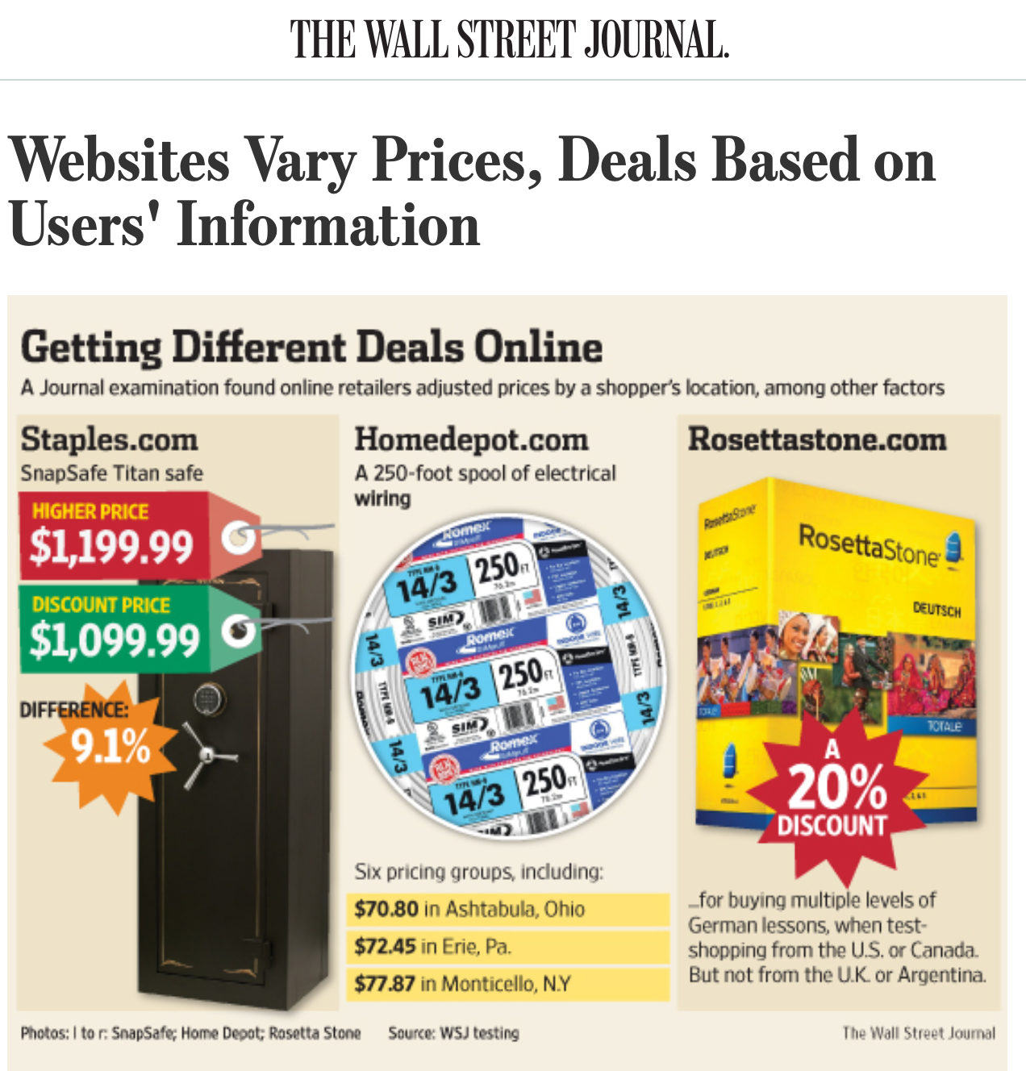
Algorithmic bias discriminates
…against the poorest of us
https://www.wsj.com/articles/SB10001424127887323777204578189391813881534
Notes:
Algorithmic bias is all too easy to introduce - it is often easy to overlook hidden correlations between inputs that we feed into our algorithms and real world attributes. For instance: price discrimination and price steering are techniques that dynamically show a different price for the same good or service to different users. For example: Staples, OfficeMax and OfficeDepot compete to sell the same products to the same customers. If I’m Staples, and I’m trying to draw customers who might otherwise go to one of my competitors, I might say something like… “If you live within 20 miles of OfficeMax or OfficeDepot, you will see a cheaper price, otherwise you’ll see more.” This could let me drive revenues: customers who would have gone to a competitor see my low prices, customers who don’t have an alternative will pay the slightly higher price anyway.
On the surface, this sounds fine. But: what if OfficeMax + OfficeDepot are primarily located in wealthy areas? If so, then our policy is actually saying: on the whole, charge wealthy customers less than poor customers. Whether this is an OK policy or not is a topic for a class on business ethics - what our interest as software engineers is is simply in recognizing that this could be an unintended harm.

Slide 13
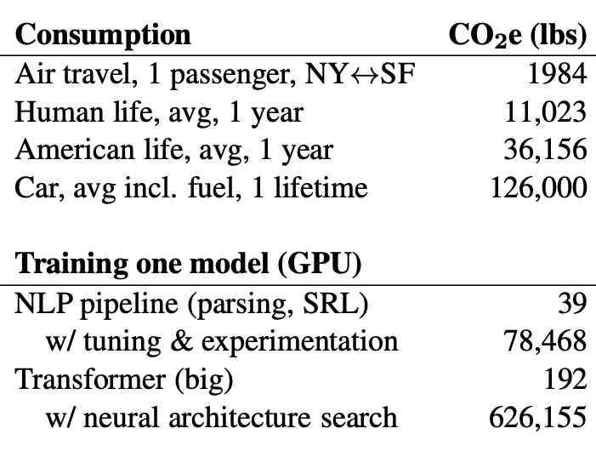
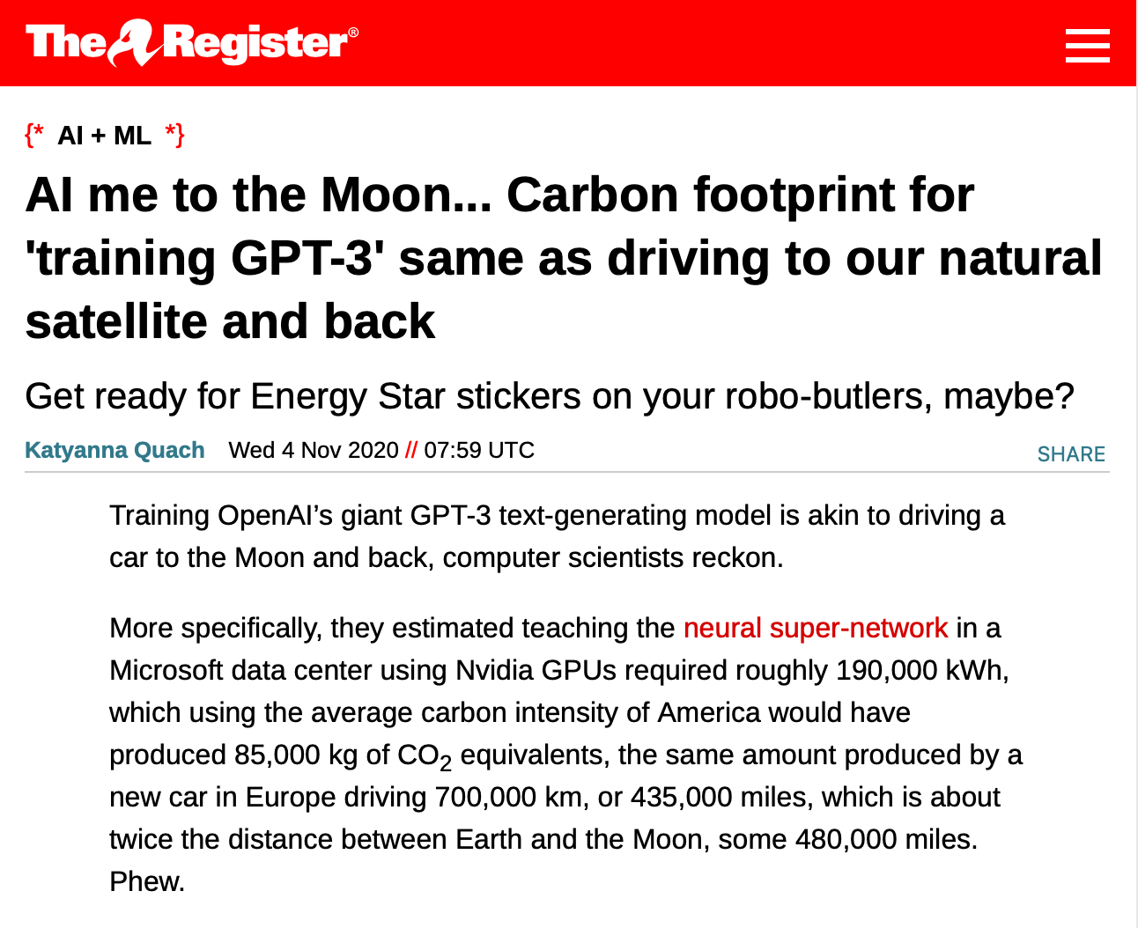
Training AI systems impacts climate
“Energy and Policy Considerations for Deep Learning in NLP” by Strubell et al in ACL19
https://www.theregister.com/2020/11/04/gpt3_carbon_footprint_estimate/
Notes:
As we build more and more complex software and in particular, machine learning models, it is also becoming increasingly important to quantify the climate impact of our software. For example, consider training GPT-3, which is the huge text-generation model that lets gmail/google docs auto-complete your sentences and write entire documents for you. The power consumption of the training process was equivalent to driving a car for 435,000 miles. Other studies have pointed out that in training and developing models, there’s often an even greater carbon impact. Again, this is not to say that we shouldn’t create machine learning models, but rather, simply to point out that this may be an unintended harm.
And Machine Learning is not the only application that uses huge amounts of energy (click)
Once we recognize the potential for harm, we can consider mitigation steps like locating our data centers in regions that provide for cheap renewable energy and cooling.

Slide 14
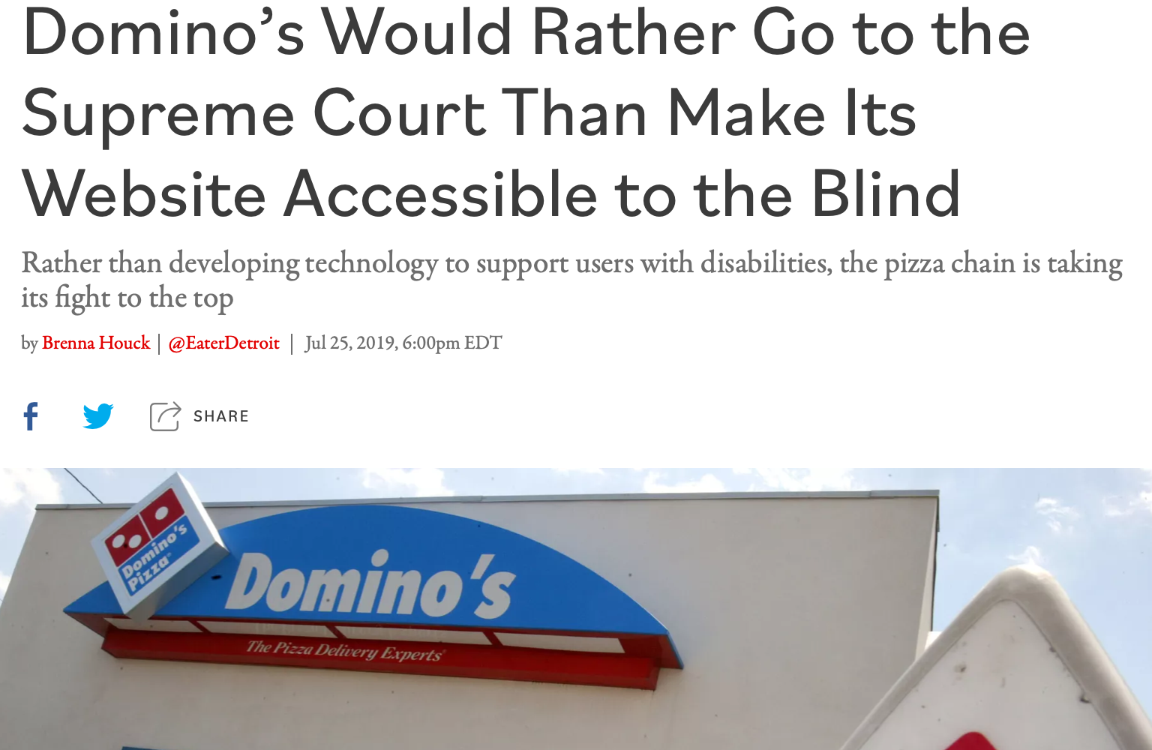
UIs discriminate against differently-abled
Inclusivity and Accessibility: Domino’s Pizza LLC v. Robles
“Domino’s Would Rather Go to the Supreme Court Than Make Its Website Accessible to the Blind” by Brenna Houck, Eater Detroit
Notes:
There are also very direct ways that we can inadvertently construct software that is not inclusive of all of our users. For instance: is our software accessible to users who have disabilities, such as being blind or low-vision? The Americans with Disabilities Act requires that public places must be accessible to people with disabilities. In 2019 a blind man sued Domino’s for not providing an interface for ordering pizza that was compatible with screen-readers, which is a kind of technology that is key to making computer accessible to the blind.
Dominos argued that the ADA only applies to physical interactions, since it was written before Internet, so how are we supposed to know what an accessible website is? The question brought before the supreme court, was, basically: do online retailers need to provide an accessible website? Many within the retail and restaurant industries filed amicus briefs backing Domino’s, stressing the “impossibility of guessing what accessibility means in the online environment.” The supreme court found that the ADA applies to websites, too. We’ll come back to this example in our next lesson.
http://jlsp.law.columbia.edu/2020/02/13/inaccessible-pizza-delivery-and-the-future-of-the-ada/

Slide 15
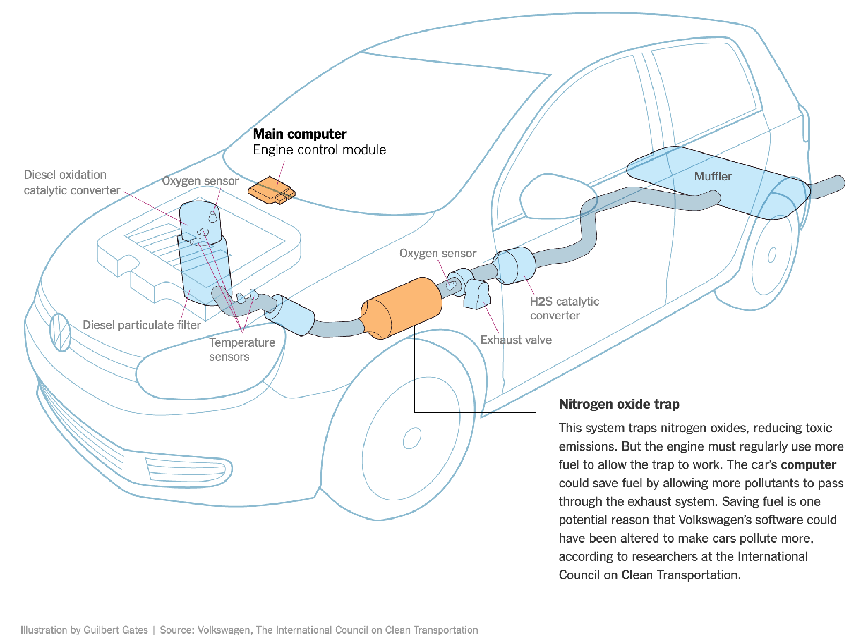
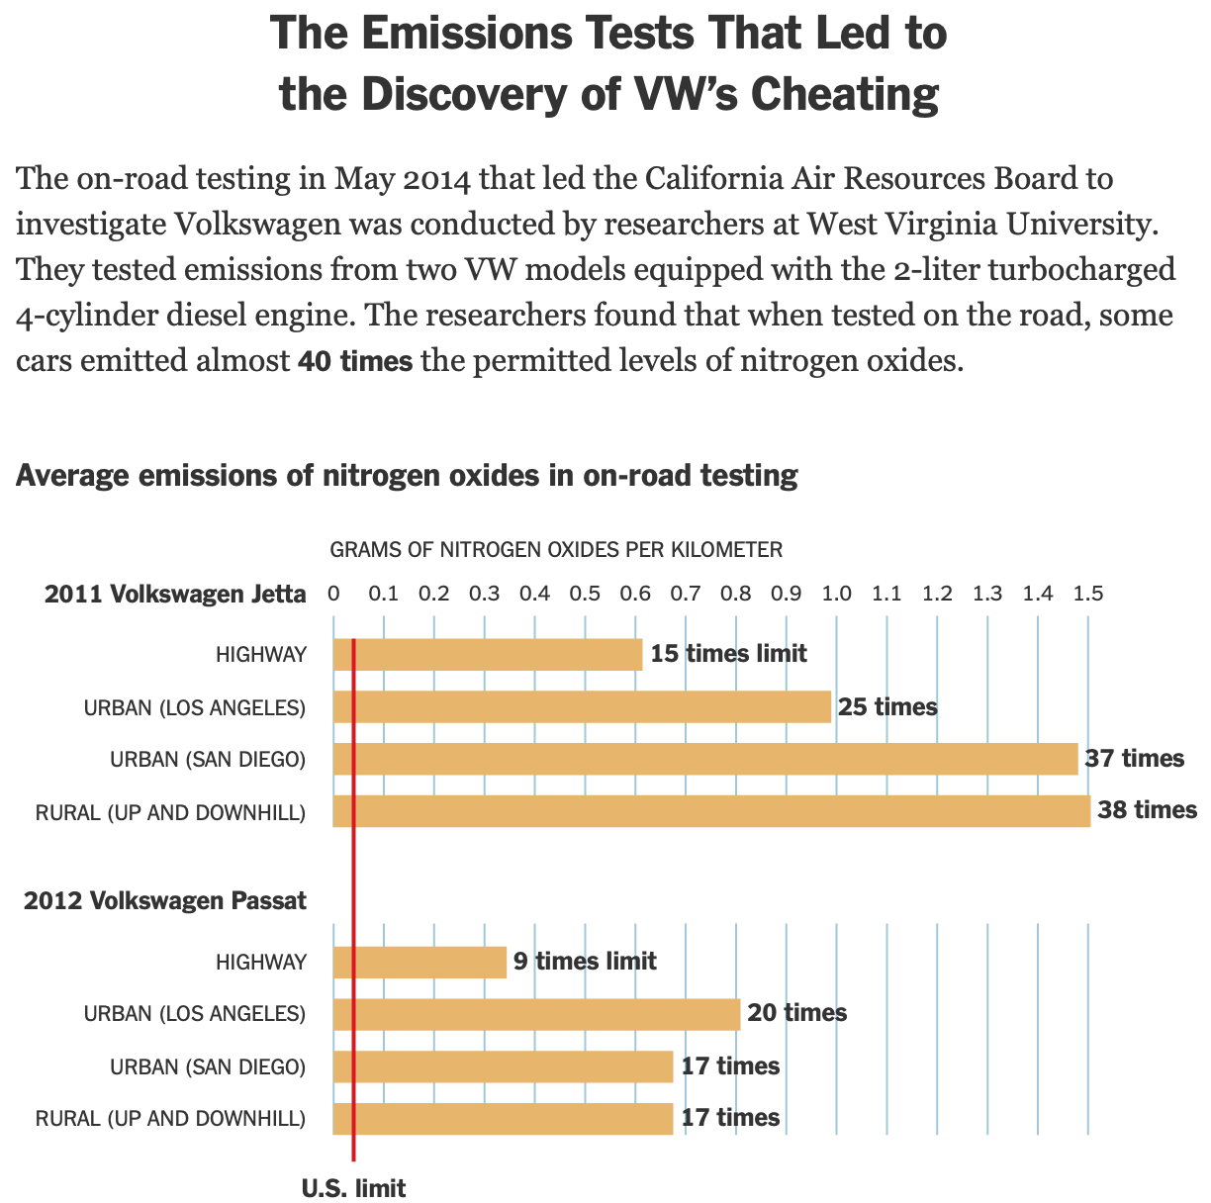
Software evades regulation
Example: Volkswagen diesel emissions
$14.7 billion settlement
“How Volkswagen’s ‘Defeat Devices’ Worked” By Guilbert Gates, Jack Ewing, Karl Russell and Derek Watkins
Notes:
It’s hard to talk about engineering equitable software and not bring up the Volkswagen emissions testing defeat device. If you’re not familiar with this scandal: cars are held to a particular emissions standard. Particularly in diesel cars, reducing emissions often tracks with reducing performance. Again, the question of “how much emissions are too much, if any” is out of scope for this discussion, and instead, we’re focusing on the regulations that existed at the time of this scandal. Cars are tested for this emissions standard in off-road simulators, where they can be easily hooked up to equipment that directly measures their emissions. Volkswagen’s engine control unit had customized software to detect when the car was under an emissions test and tune the engine to reduce performance and emissions, resulting in emissions tests that significantly under-represented the actual emissions of the vehicle. (Click) This software mislead regulators and consumers, and ultimately Volkswagen agreed to spend $14.7 billion in a settlement, and was subject to significant public relations damage.

Slide 16
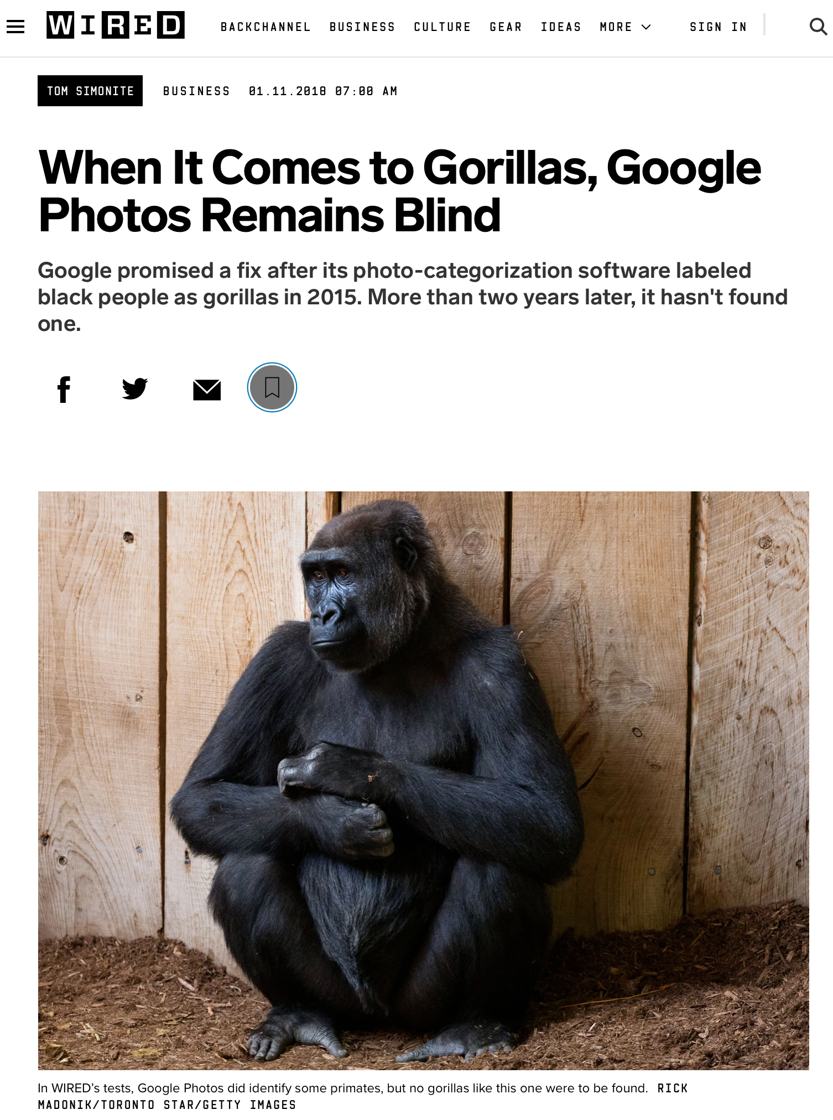
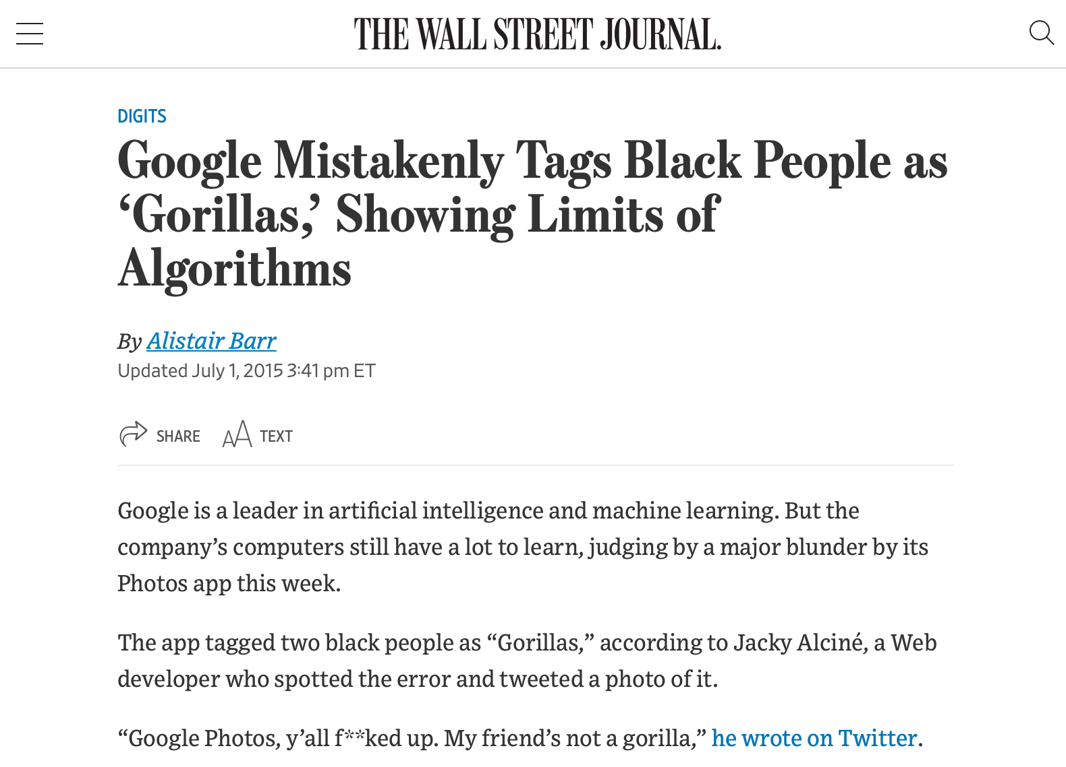
Bias is the Default
Example: Google Photos auto-tagging
https://www.wsj.com/articles/BL-DGB-42522
https://www.wired.com/story/when-it-comes-to-gorillas-google-photos-remains-blind/
Notes:
As a case example of bias as the default, consider this incident from 2015, when google released a new photo tagging feature in Google Photos, which was prone to misidentify black people in photographs as gorillas. How did this happen? Image recognition algorithm depend on being supplied a proper (complete) dataset - clearly an incomplete dataset, not representative of entire population. Why didn’t this come up in internal testing? To the extent that Google has a diverse development team today, that was much less true in 2015 - so nobody was trying it and finding this out, and the unconscious bias of the organization resulted in this product getting out. This was harmful both to users, and to Google’s reputation. Even today, this is not very well fixed - and is mostly side-stepped by not identifying any image as a gorilla. It’s useful to think of a case like this to set the tone for a conversation about diversity and inclusivity, but there are many more subtle biases in our software.

Slide 17
Reflecting on these examples
Personal philosophies and business cases
Notes:
Regardless of your personal ethical philosophy, and whether you think that it was OK or not for these companies to build these applications in these ways, I hope that we can all see a simple business case that argues for avoiding behaviors that will result in the kinds of negative public relations fiascos that these companies faced. Quite often when developing a product, we are faced with the choice of the fast option that provides inequitable outcomes.
Sometimes, making our software equitable simply means an additional set of implementation tasks - like making the dominos app work with a screenreader.
Other times, we may need to seriously examine the systems of inequality that our software is built on: how can we build a system to predict criminal recidivism if we acknowledge that the data that we base these models off of is inherently biased?

Slide 18
More than don’t be evil
Engineering equitable software requires conscious effort
How do we determine what “the right thing” is?
How do we convince our investors/managers to take this action?
Notes:
Engineering equitable software requires conscious effort. It is not simple enough to take on a motto like “don’t be evil” or “do the right thing,” when it is often difficult to fully comprehend the societal impacts of our technical decisions. Moreover, even when we do see a clear potential harm to some portion of the population, taking corrective action can be challenging.

Slide 19
How to mitigate harms in software?
What are you trying to solve?​
For every software you create, include a wide range of people to use it
Including more people helps detect biases and harms
Iterate your software throughout its entire life cycle.

Slide 20
How to write software for people that mitigates harm
https://www.microsoft.com/en-us/research/uploads/prod/2020/03/Guidelines_summary_image@2x.png

Slide 21
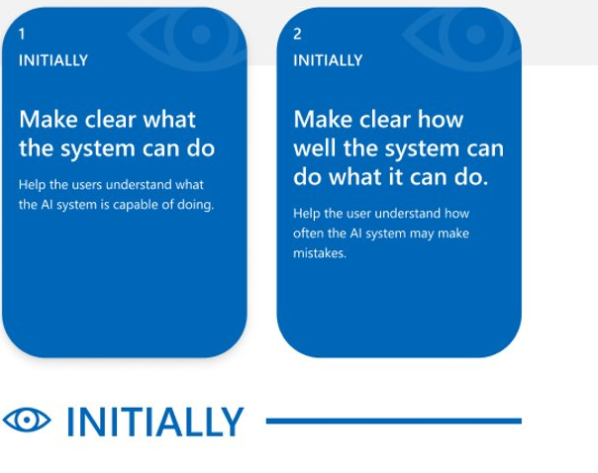

Slide 23
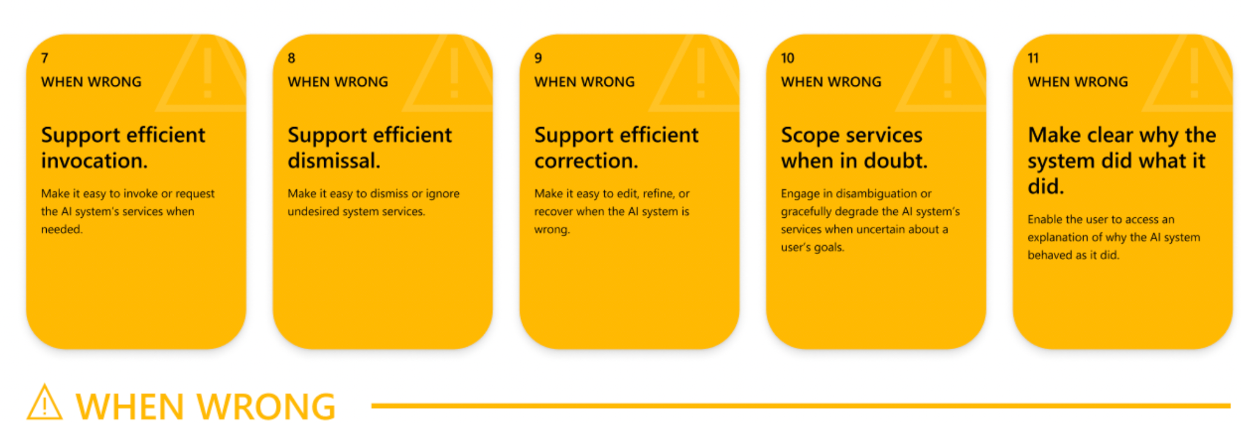

Slide 25
Where does this leave us?
So that we can sleep at night
Consider the different ways that our software may impact others
Consider the ways in which our software interacts with the political, social, and economic systems in which we and our users live
Follow best practices, and actively push to improve them
Encourage diversity in our development teams
Engage in honest conversations with our co-workers and supervisors to explore possible ethical issues and their implications.
Notes:
There’s no silver bullet for ethical software development. However, hopefully now you understand better the different ways that our software can have impacts on others, and how we can reason about those implications. We have talked about understanding users’ needs better which can be helpful in making better decisions

Slide 26
Learning Goals
You should now be able to…
Suggest how software can cause inadvertent harm or amplify inequities
Explain why software engineers have a role to play in avoiding such harms

Slide 27
Exercise
Team up and propose actionable ideas to re-design Amazon’s Hiring Software
Notes:
For Amazon's A.I. system define how you would re-design for the system to follow these A.I. guidelines. ​

